Slide 1
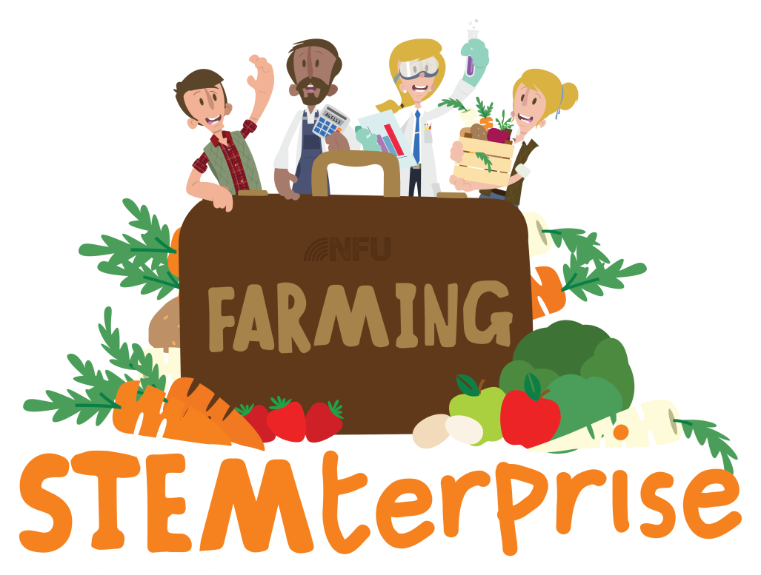
Stage 10 Designing an advertising campaign

Slide 2
Promotion
Businesses use promotion to tell possible customers all about their product.
Promotion is used to advertise the benefits of the product and why it is better than competitors.
You can use promotion to persuade customers to buy your product.
Can you think of any ways that businesses do this?

Slide 3
Methods of Promotion
Advertising: TV or magazine adverts, posters, leaflets, flyers, brochures
Special offers: price reductions, competitions, free samples
Endorsements by celebrities

Slide 4
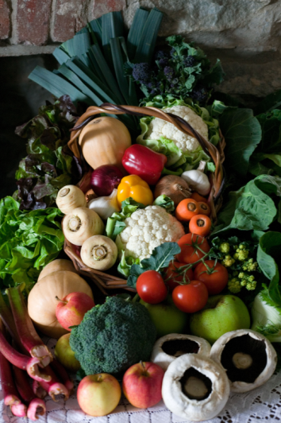
Exploring food advertising
Look at the food advertising on your table.
How do they encourage customers to buy more of their products?
Can you find any of the key features of persuasive writing?

Slide 5
Promoting your product
Design a poster, flyer or leaflet to promote your product.
Think about how to appeal to your target market.
What features of language will you need to persuade people to buy it?
Think about other promotional strategies that you can use on your advert. For example, special offers.

Slide 6
Promoting your product
Write and perform a television or radio advertisement for your restaurant.
Think about how to appeal to your target market.
What features of language will you need to persuade people to buy it?

Slide 7
Packaging
Most of takeaway food products come in packaging.
Some packaging can be recycled but a lot of it cannot.
Lots of our takeaway food is packaging in single- use plastic that cannot be recycled.

Slide 8
Notes:
Plastic waste does not decay quickly. Therefore, plastic waste that ends up in the oceans is likely to remain there for decades.
There are many examples of where animals have become entangled in plastic waste such as plastic bags, bottle and discarded nylon fishing nets.

Slide 9
Notes:
In the UK, we now recycle a lot of our waste plastic. However, plastic in the form of polythene and clingfilm ends up in landfill.
Some households do not recycle waste and waste from litter bins in public places is rarely sorted for recycling.

Slide 10
Designing your packaging
Design and make the packaging for your takeaway product.
Think about the materials you will use.
Think about how to appeal to your target market.
How will you make your product stand out from the competitors on the street? Your customers should act as advertisements for your restaurant.

